Slide 1






Ground State Phase Transitions in the 2-site XY Model
[Text]
No. DE-SC0019469
Zero Temperature Phase Transitions in the 2-site XY Model

Slide 2
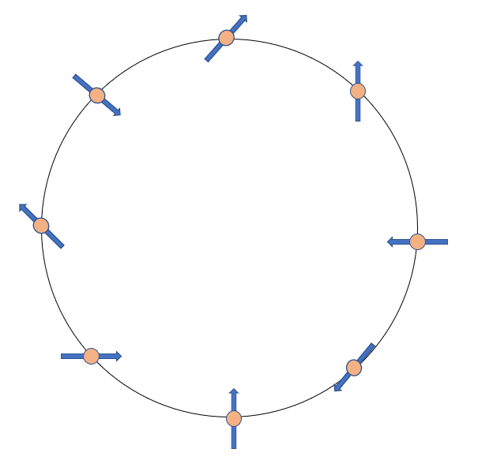
XY Model
One dimensional chain of lattice sites
Nearest neighbor spin interactions for x and y components of spin
[Text]
[Text]
Periodic boundary condition
σ_{N+1} = σ₀
Zero Temperature Phase Transitions in the 2-site XY Model

Slide 3
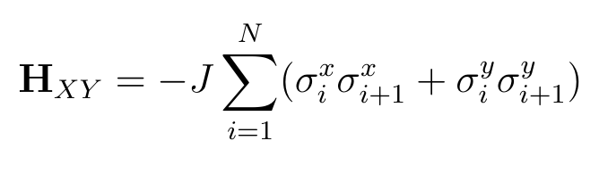
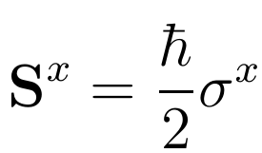
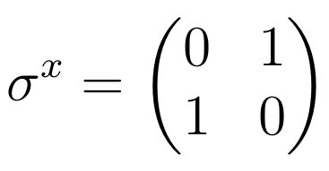
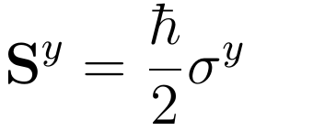
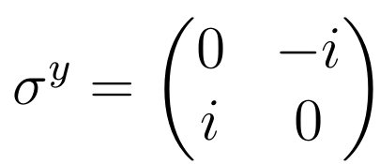
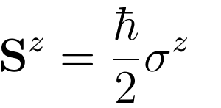
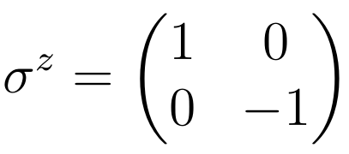
XY Model
Hamiltonian
[Text]
[Text]
Zero Temperature Phase Transitions in the 2-site XY Model

Slide 4
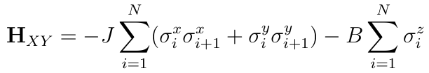
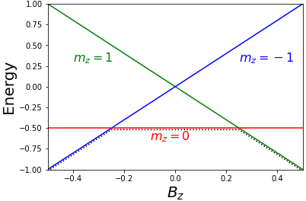
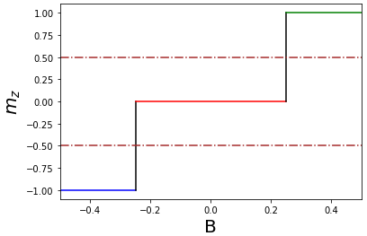
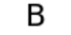
Phase Transitions
Zero Temperature Phase Transitions in the 2-site XY Model

Slide 5

Adiabatic State Preparation
“A system remains in its initial state if a slow enough perturbation acts upon it”
[Text]
[Text]
Zero Temperature Phase Transitions in the 2-site XY Model

Slide 6
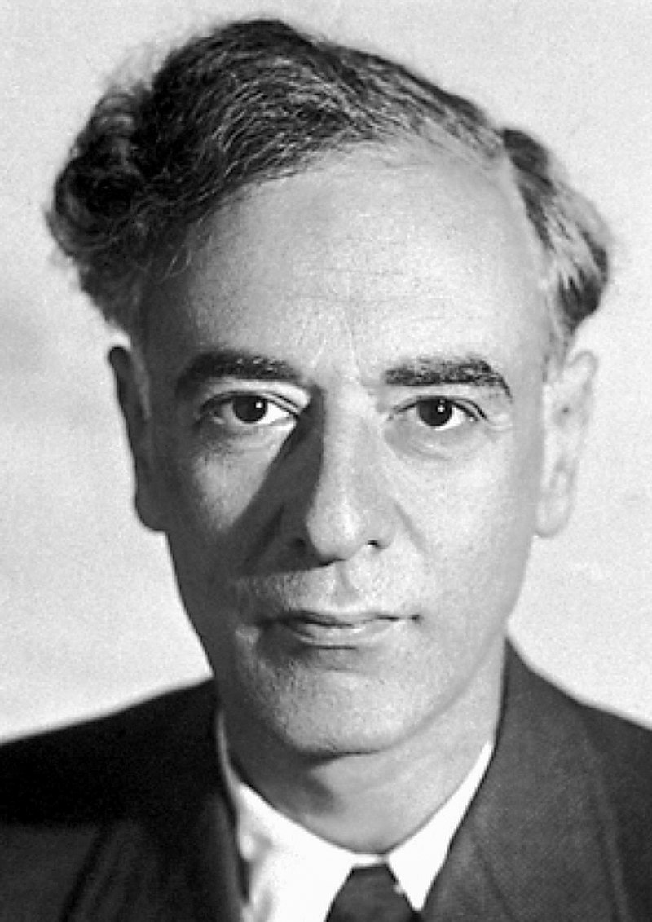
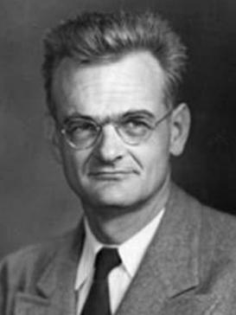
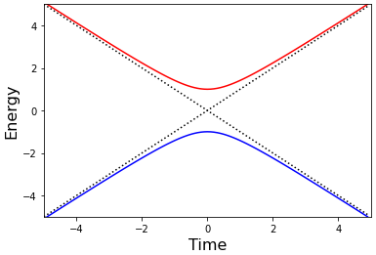
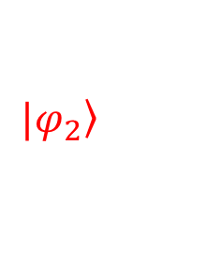
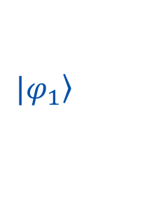
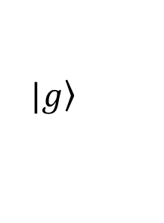
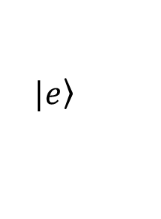
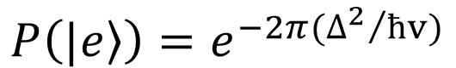
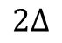
Landau – Zener Formula
$$P\left(\left.|e\right\rangle \right)=e^{−2π({∆^{2}}/{ħv)}}$$
$$\left.|e\right\rangle$$
$$\left.{|φ}_{2}\right\rangle$$
[Text]
[Text]
$$2∆$$
$$\left.{|φ}_{1}\right\rangle$$
$$\left.|g\right\rangle$$
Zero Temperature Phase Transitions in the 2-site XY Model

Slide 7

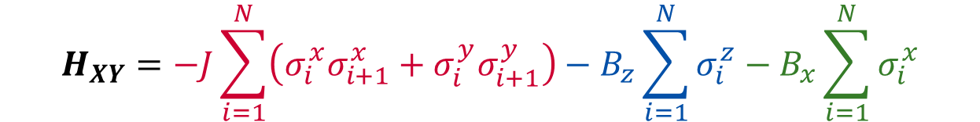
Modifying the XY Model
Solution to commuting operators:
Determine the ground state “variationally” for many different values of B to determine phase transition
Modify Hamiltonian to guarantee coupling for adiabatic state preparation
[Text]
[Text]
$$H_{XY}=−J\sum_{i=1}^{N}{\left(σ_{i}^{x}σ_{i+1}^{x}+σ_{i}^{y}σ_{i+1}^{y}\right)−B_{z}\sum_{i=1}^{N}{σ_{i}^{z}}−B_{x}\sum_{i=1}^{N}{σ_{i}^{x}}}$$
Zero Temperature Phase Transitions in the 2-site XY Model

Slide 8
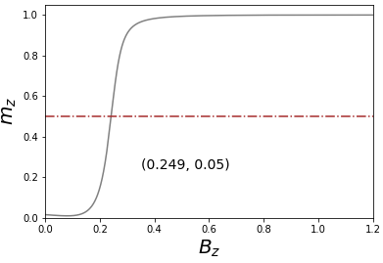
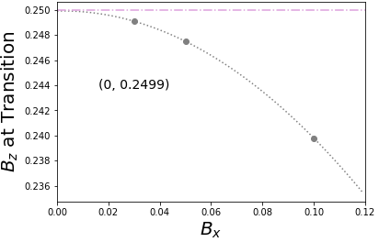
Scaling to Phase Transition
Zero Temperature Phase Transitions in the 2-site XY Model

Slide 9
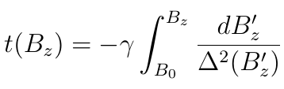
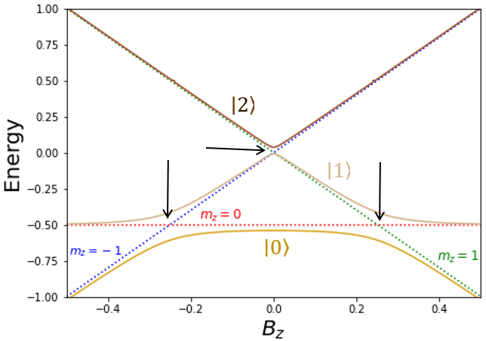
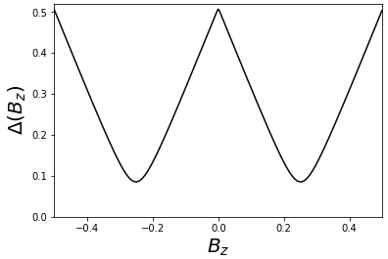
Local Adiabatic Ramp
[Text]
[Text]
Zero Temperature Phase Transitions in the 2-site XY Model

Slide 10
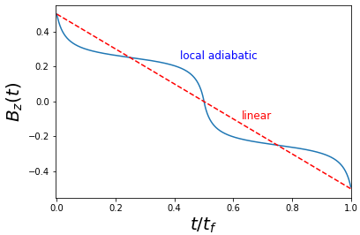
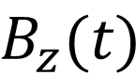
Local Adiabatic Ramp
Spline + Invert
$$B_{z}(t)$$
[Text]
[Text]
Zero Temperature Phase Transitions in the 2-site XY Model

Slide 11
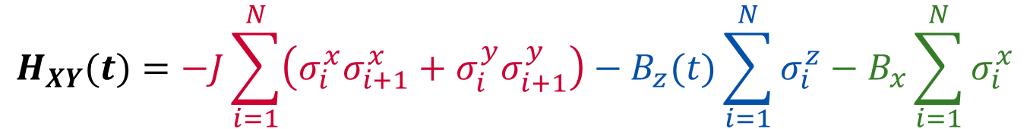
Decomposing the XY Model
$$H_{XY}(t)=−J\sum_{i=1}^{N}{\left(σ_{i}^{x}σ_{i+1}^{x}+σ_{i}^{y}σ_{i+1}^{y}\right)−B_{z}(t)\sum_{i=1}^{N}{σ_{i}^{z}}−B_{x}\sum_{i=1}^{N}{σ_{i}^{x}}}$$
[Text]
[Text]
Transform the XY Hamiltonian into a unitary operator and decompose using the Trotter approximation for time-evolution.
Zero Temperature Phase Transitions in the 2-site XY Model

Slide 12
Decomposing the XY Model
$$H_{XY}(t)=−J\sum_{i=1}^{N}{\left(σ_{i}^{x}σ_{i+1}^{x}+σ_{i}^{y}σ_{i+1}^{y}\right)−B_{z}(t)\sum_{i=1}^{N}{σ_{i}^{z}}−B_{x}\sum_{i=1}^{N}{σ_{i}^{x}}}$$
Direct Solution: Decompose XY Hamiltonian into 3 components
[Text]
[Text]
$e^{−iH_{XY}(t) ∆t}≈e^{−iH_{J}∆t}{ e}^{−iH_{B_{z}}(t)∆t}$ $e^{−iH_{B_{x}}∆t}$
Zero Temperature Phase Transitions in the 2-site XY Model

Slide 13
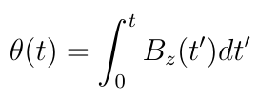
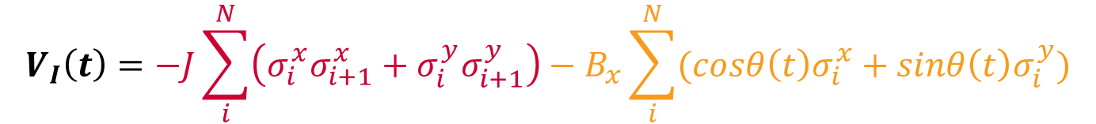
Interaction Representation
Alternative Solution: Decompose XY Hamiltonian into the interaction picture
$$V_{I}\left(t\right)=−J\sum_{i}^{N}{\left(σ_{i}^{x}σ_{i+1}^{x}+σ_{i}^{y}σ_{i+1}^{y}\right)}−B_{x}\sum_{i}^{N}{(cosθ\left(t\right)σ_{i}^{x}+sinθ\left(t\right)σ_{i}^{y})}$$
[Text]
[Text]
Zero Temperature Phase Transitions in the 2-site XY Model

Slide 14
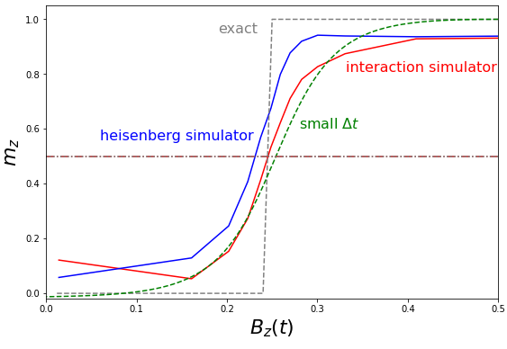
Interaction Representation
[Text]
[Text]
Zero Temperature Phase Transitions in the 2-site XY Model

Slide 15
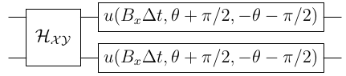
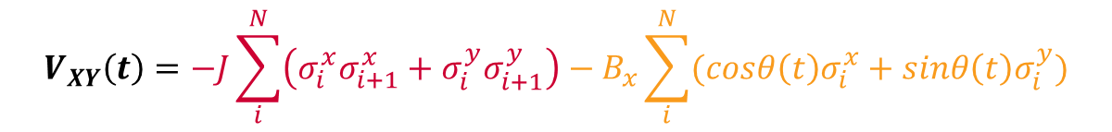
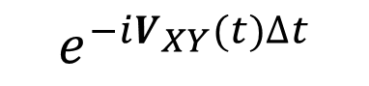
Quantum Circuit for the XY Model
$$V_{XY}\left(t\right)=−J\sum_{i}^{N}{\left(σ_{i}^{x}σ_{i+1}^{x}+σ_{i}^{y}σ_{i+1}^{y}\right)}−B_{x}\sum_{i}^{N}{(cosθ\left(t\right)σ_{i}^{x}+sinθ\left(t\right)σ_{i}^{y})}$$
$$e^{−iV_{XY}(t)∆t}$$
=
[Text]
[Text]
The 2-site XY model contains 2 CNOTs per Trotter step for 2N CNOTs for a complete time-evolution.
Zero Temperature Phase Transitions in the 2-site XY Model

Slide 16
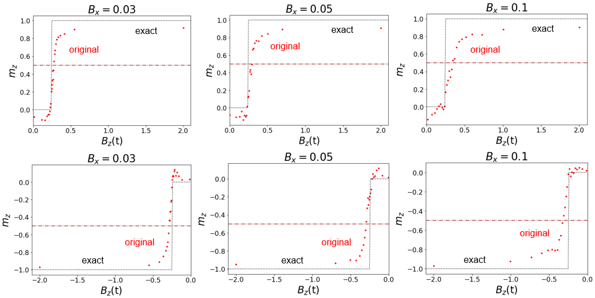
Calculating the Phase Transition
[Text]
[Text]
Zero Temperature Phase Transitions in the 2-site XY Model

Slide 17
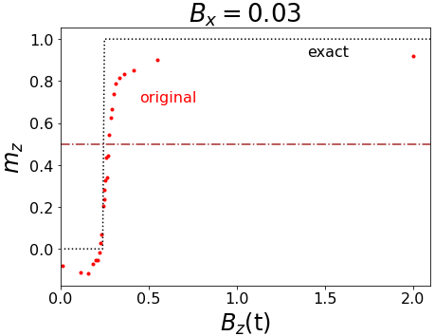
Calculating the Phase Transition
[Text]
[Text]
Zero Temperature Phase Transitions in the 2-site XY Model

Slide 18
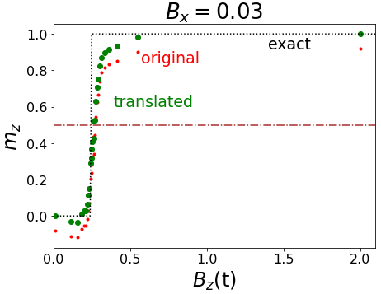
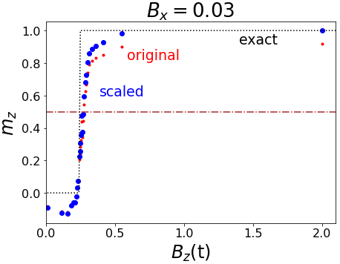
Calculating the Phase Transition
[Text]
[Text]
Zero Temperature Phase Transitions in the 2-site XY Model

Slide 19
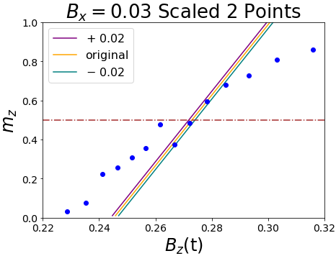
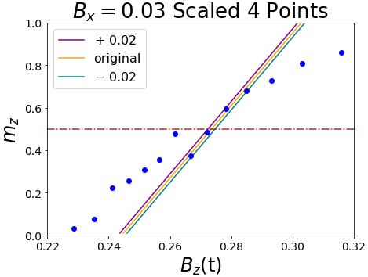
Calculating the Phase Transition
[Text]
[Text]
Zero Temperature Phase Transitions in the 2-site XY Model

Slide 20
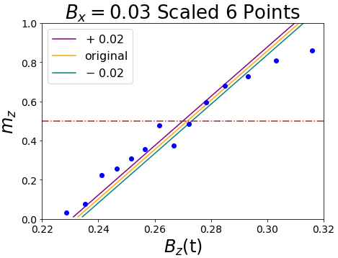
Calculating the Phase Transition
[Text]
[Text]
Zero Temperature Phase Transitions in the 2-site XY Model

Slide 21
Calculating the Phase Transition
[Text]
[Text]
Zero Temperature Phase Transitions in the 2-site XY Model

Slide 22
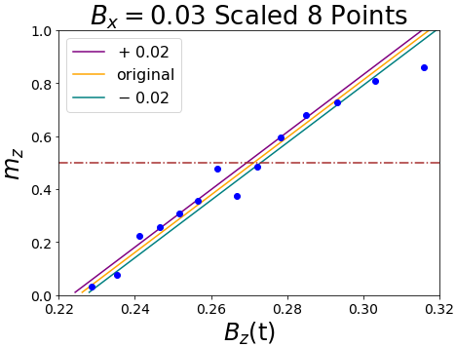
Calculating the Phase Transition
[Text]
[Text]
Zero Temperature Phase Transitions in the 2-site XY Model

Slide 23
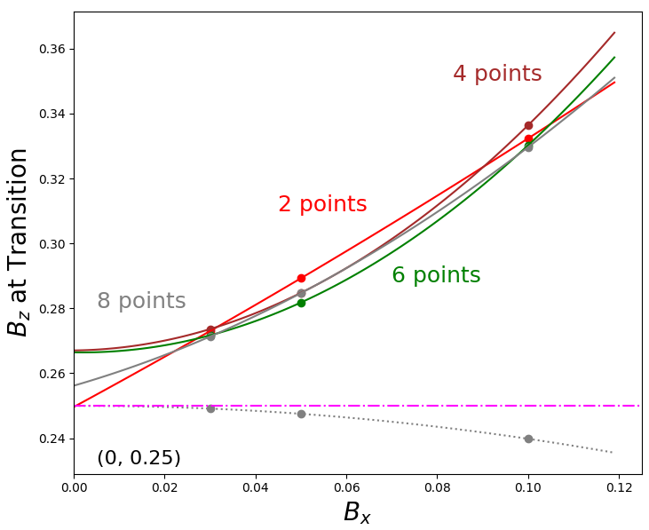
Calculating the Phase Transition
[Text]
[Text]
exact
Zero Temperature Phase Transitions in the 2-site XY Model

Slide 24
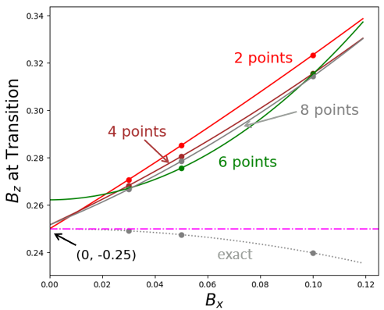
Calculating the Phase Transition
[Text]
[Text]
exact
Zero Temperature Phase Transitions in the 2-site XY Model

Slide 25
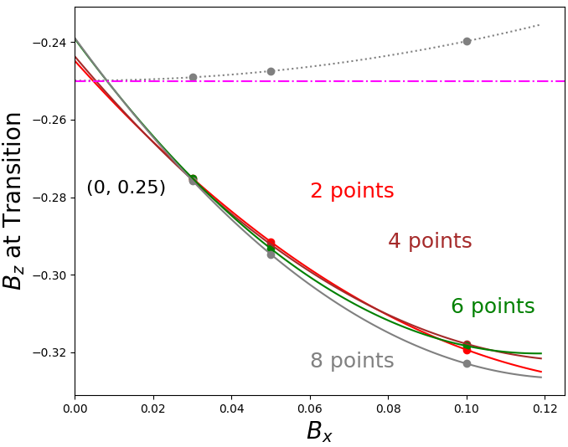
Calculating the Phase Transition
exact
(0, -0.25)
[Text]
[Text]
Zero Temperature Phase Transitions in the 2-site XY Model

Slide 26
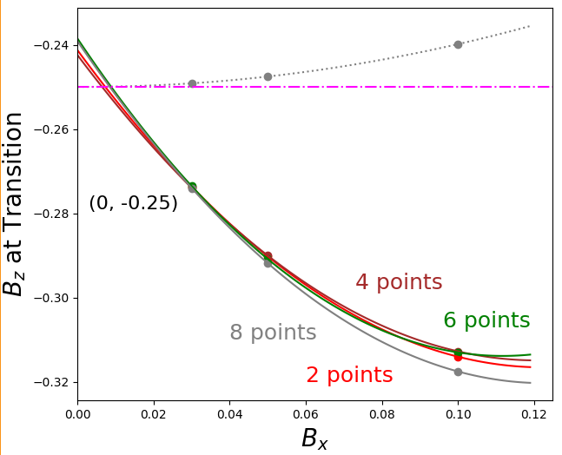
Calculating the Phase Transition
exact
Zero Temperature Phase Transitions in the 2-site XY Model

Slide 27
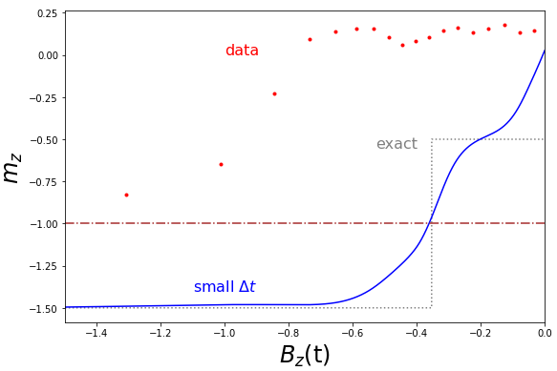
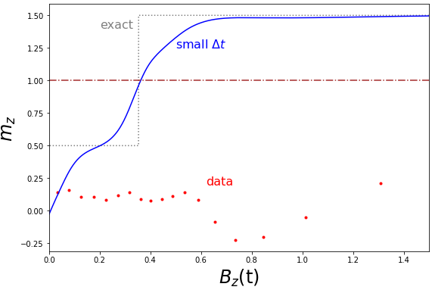
3 Site System

Slide 28
Thank You
[Text]
[Text]
No. DE-SC0019469
Zero Temperature Phase Transitions in the 2-site XY Model

Slide 29



Appendix A
Let |M> and |N> be eigenstates of S^{z}, and let λ_{M} and λ_{N} be eigenvalues of S^{z}. For |M> ≠ |N>,
$$0$$
[Text]
[Text]
Zero Temperature Phase Transitions in the 2-site XY Model

Slide 30

Appendix B
[Text]
[Text]
* Target of 50 CNOTs for time-evolution
Zero Temperature Phase Transitions in the 2-site XY Model

Slide 31







Appendix C
$$H_{0}\left(t\right)=−B_{z}(t)\sum_{i}{σ_{i}^{z}}$$
$$V\left(t\right)=−\sum_{i}{J\left(σ_{i}^{x}σ_{i+1}^{x}+σ_{i}^{y}σ_{i+1}^{y}\right)−B_{x}(t)\sum_{i}{σ_{i}^{x}}}$$
$$U_{0}\left(t, t_{0}\right)=e^{+i\int_{t_{0}}^{t}{B_{z}(t^{′})\sum_{i}{σ_{i}^{z}dt^{′}}}}$$
$$U_{I}\left(t, t_{0}\right)=e^{−i\int_{t_{0}}^{t}{V_{I}\left(t^{′}\right)dt^{′} }}$$
[Text]
$$U\left(t,t_{0}\right)=U_{0}\left(t, t_{0}\right)U_{I}\left(t, t_{0}\right)$$
$iħ\frac{d}{dt}U\left(t,t_{0}\right)$= [$H_{0}\left(t\right)+V(t)] U\left(t,t_{0}\right)$
$iħ\frac{d}{dt}U_{I}\left(t,t_{0}\right)$= $V_{I}\left(t \right)U_{I}(t,t_{0})$
Zero Temperature Phase Transitions in the 2-site XY Model

Slide 32





Appendix D
[Text]
[Text]
Zero Temperature Phase Transitions in the 2-site XY Model

